Slide 1
Analyzing Home Credit Default Risk
Muhammad Kashif
Audrey Nkrumah
Lovepreet Singh
Vinay Vattipally

Slide 2
Project Overview
Lots of folks find it hard to borrow money because they don't have enough or any credit history. Sadly, some dishonest lenders take advantage of these people.
This project is aimed at building a highly accurate predictive model that can predict risk probability of default for loan applicants based on the dataset provided by the home credit and we went further to calculate amount of loan customer can get if one is at low risk of default.
After analyzing the data, which met all the requirement to building this model was met, we divided the task into 4 main parts and distributed amongst group members.
Data Source: https://kaggle.com/competitions/home-credit-default-risk

Slide 3
Process Task Flow
ETL & EDA (Extract, Transform, Load & Exploratory Data Analysis)
Front End
Designing and developing the user interface (UI) and user experience (UX) components of the application or system.
Includes creating layouts, implementing functionality, and ensuring a seamless and intuitive user interface.
Preparing and cleaning the data for analysis and modeling
Transforming it into a suitable format
Loading it into the required data structures
Data Analysis and Visualizations
Analyzing the data, exploring its characteristics, identifying patterns, trends, and relationships within the data
Creating visualizations
Machine Learning and Model Integration
Developing machine learning models based on the analyzed data
Includes selecting appropriate algorithms, training and evaluating models, fine-tuning parameters, and integrating the models with the front end of the application or system

Slide 4
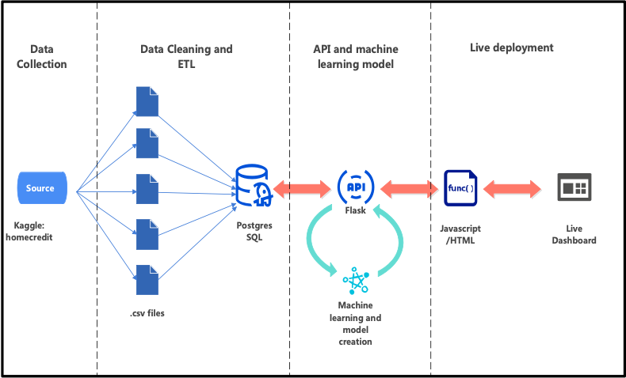
Data Architecture

Slide 5

ETL (Extract, Transform & Load)

Slide 6
Preparing and cleaning the data for analysis and modeling
Data source and acquisition process.
Data is acquired from Kaggle.com provided by Home credit Group.
Data contains files:
application_{train/test}.csv
bureau.csv
bureau_balance.csv
POS_CASH_balance.csv
credit_card_balance.csv
previous_application.csv
installments_payments.csv
HomeCredit_columns_description.csv
Description of the dataset: features, target variable
Features: Age, Gender, Education Level, Marital Status, Income, Occupation, Number of Dependents, Credit Score, Home Ownership, Loan Purpose, Loan Amount, Loan Term, etc.
Target Variable: Target

Slide 7
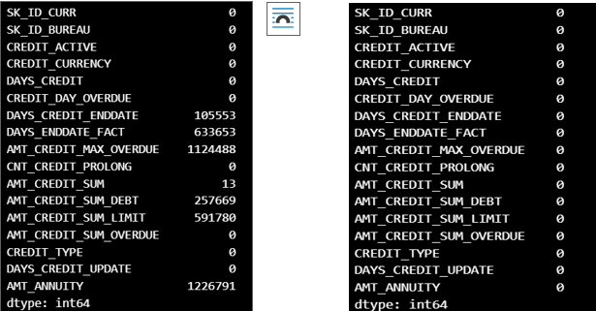
Data Preprocessing:
Handling missing values
Data obtained from source has categorical data in refined form and minimal bad entries
However Null values in were filled by putting 0 values in columns where 0 and 1 does not impact our model predictions.
The before and after of the handling of missing values is as illustrated on the image to the right

Slide 8
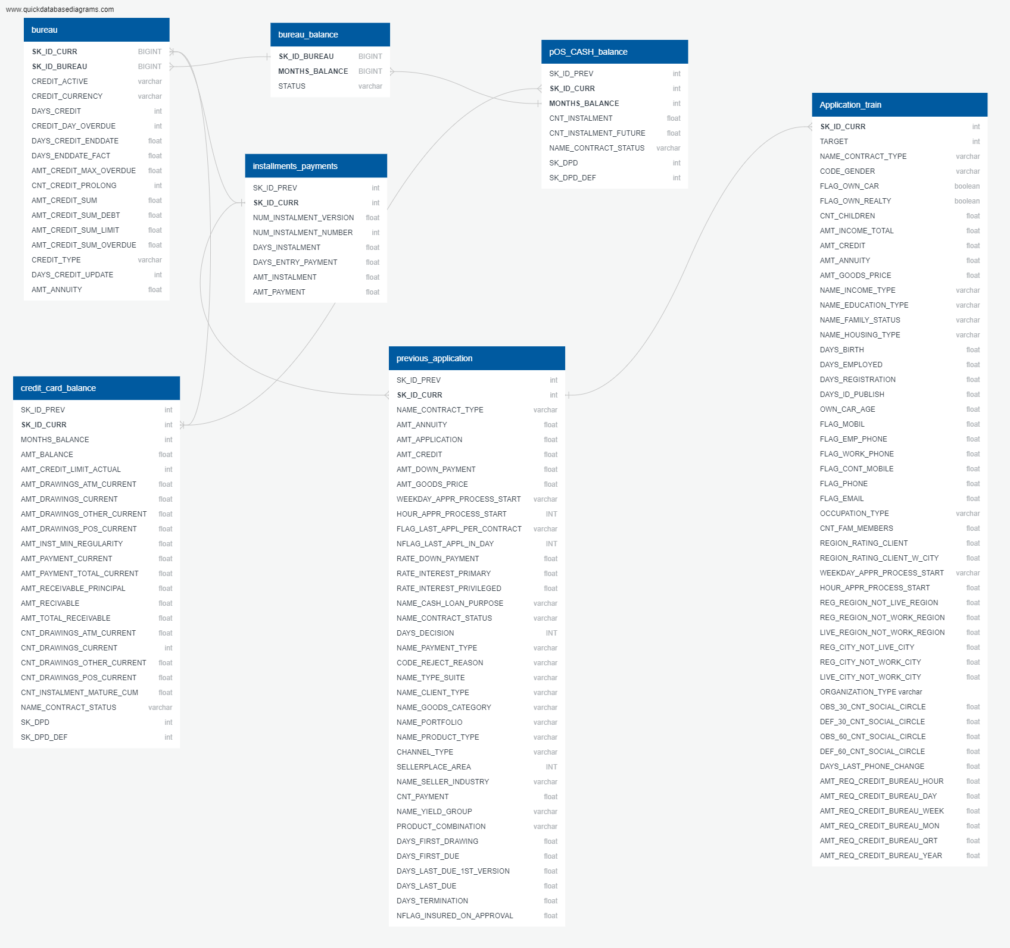
Data Preprocessing cont.
Data cleaning and formatting
After Initial cleaning and handling of missing values, CSV files are exported, a schema was created. The schema is illustrated as in the image on the right.

Slide 9
Data Preprocessing cont.
Connect to Sources(APIs):
APIs were created using Database queries, Final schema file is used to create tables in Postgresql. Tables are populated with data by using postgresqlpop.ipynb file which have functions to insert data in the database from CSV files. The app.py file has query setup to obtain data from Postgresql via APIs
Below is list of APIs:
"Bureau" : 'http://127.0.0.1:5000/bureau'
"Bureau_balance" : 'http://127.0.0.1:5000/bureau_balance'
"Credit_card_balance" : 'http://127.0.0.1:5000/credit_card_balance'
"Installments_payments" : 'http://127.0.0.1:5000/installments_payments'
"POS_CASH_balance" : 'http://127.0.0.1:5000/pOS_CASH_balance'
"Previous_application" : 'http://127.0.0.1:5000/previous_application'
"Application_train" : 'http://127.0.0.1:5000/application_train'

Slide 10
Data Preprocessing cont.
Data Retrieval from APIs:
Data is extracted from API and tables are merged together using model_probab.ipynb & model_predict.ipynb file for respective modelling purpose. -"POS_CASH_balance", "Installments_payments", "Credit_card_balance", "Previous_application" were merged on SK_ID_PREV and then the "Application_train" & "Bureau" on SK_ID_CURR while Bureau is attached with Bureau_balance at SK_ID_bureau.
Data is then used for modelling process and Data analysis.

Slide 11
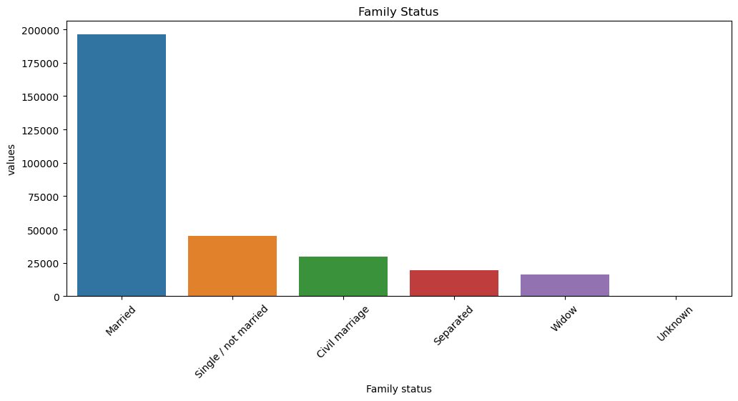
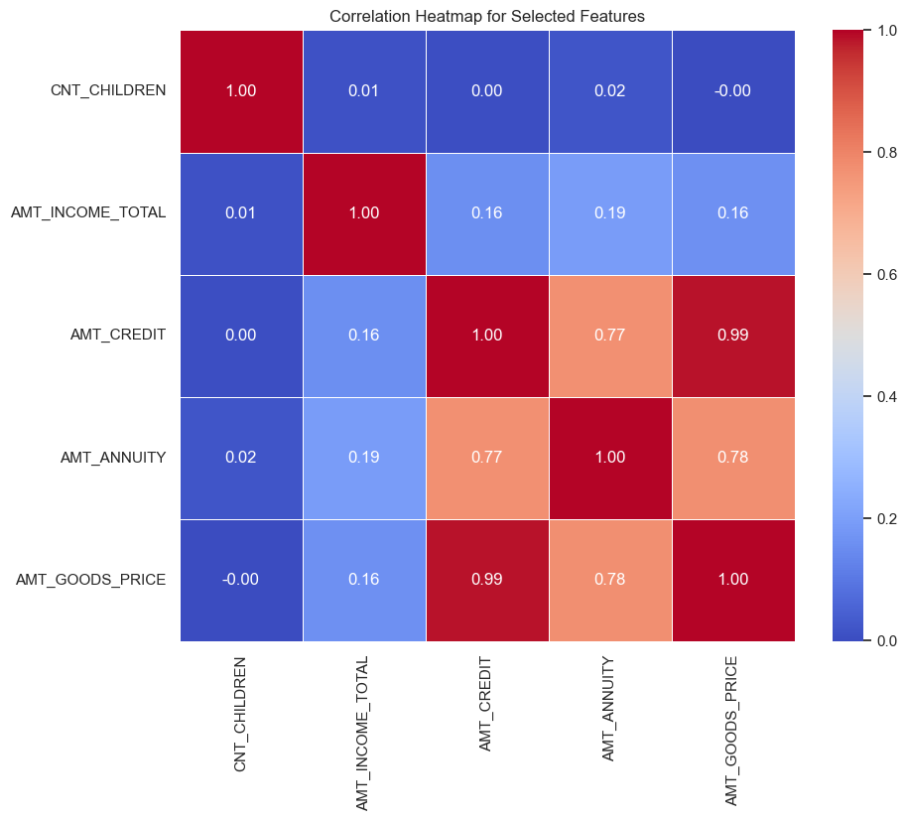

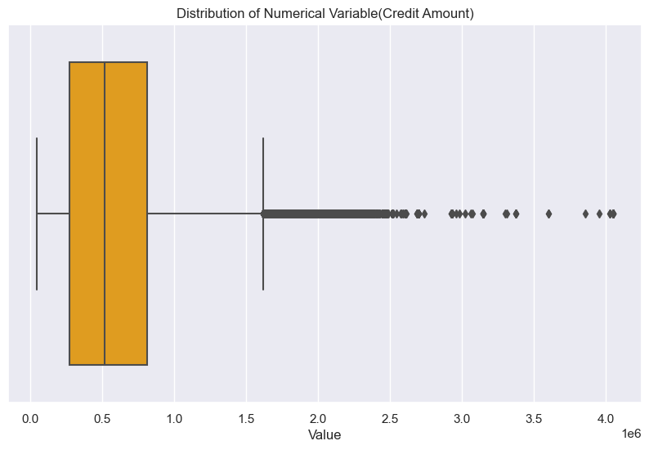

Data Analysis and Visualizations

Slide 12
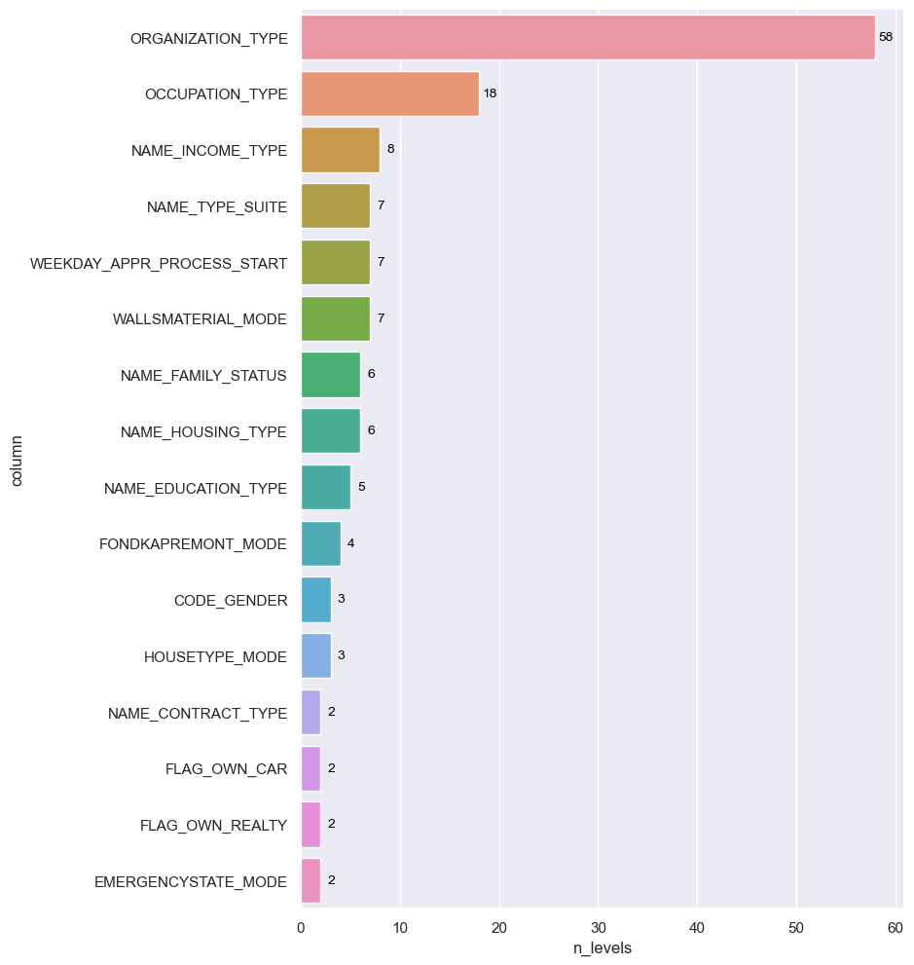
Understanding Data
The categorical Features were examined, and the unique number of levels was obtained.
It is interesting to note that origination type had the highest number (58 ) unique levels.
Followed by Occupation type with 18 unique levels then Income type and so on as depicted in the image on the right.
The least number of unique levels was 2 in contract type, car and the likes.

Slide 13
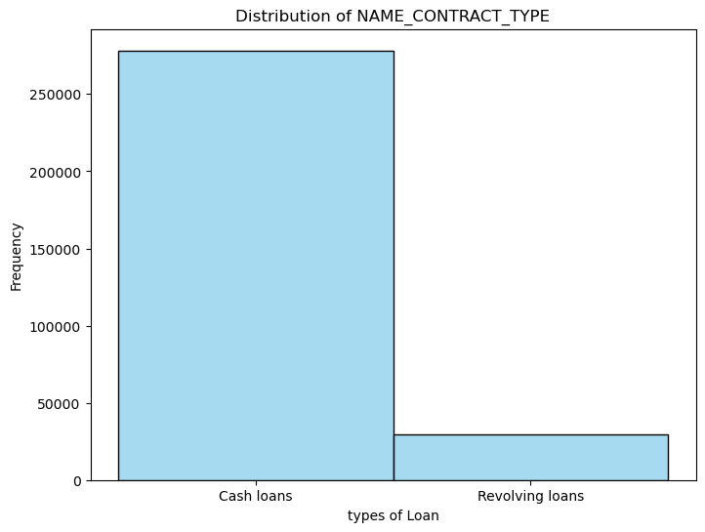
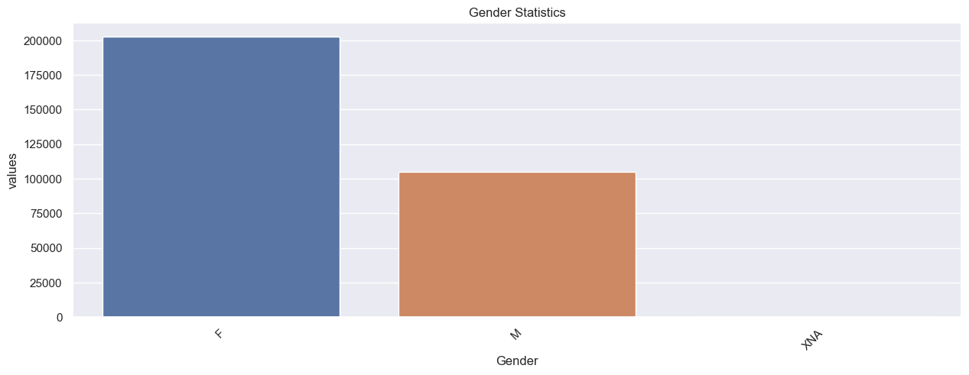
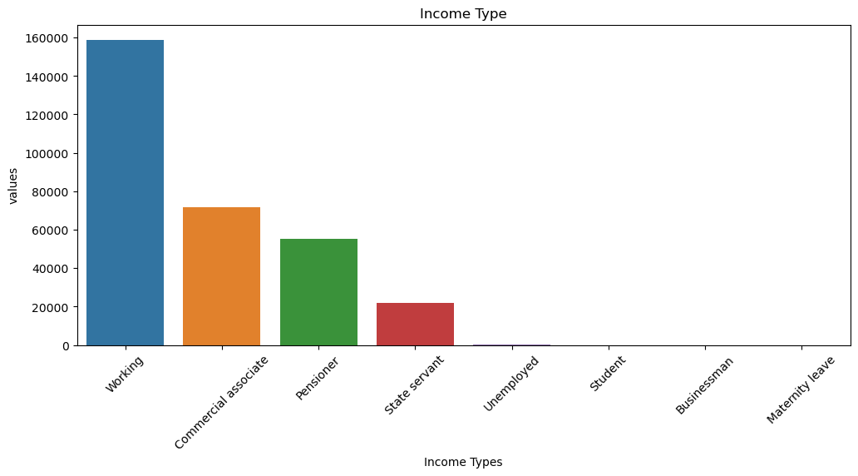
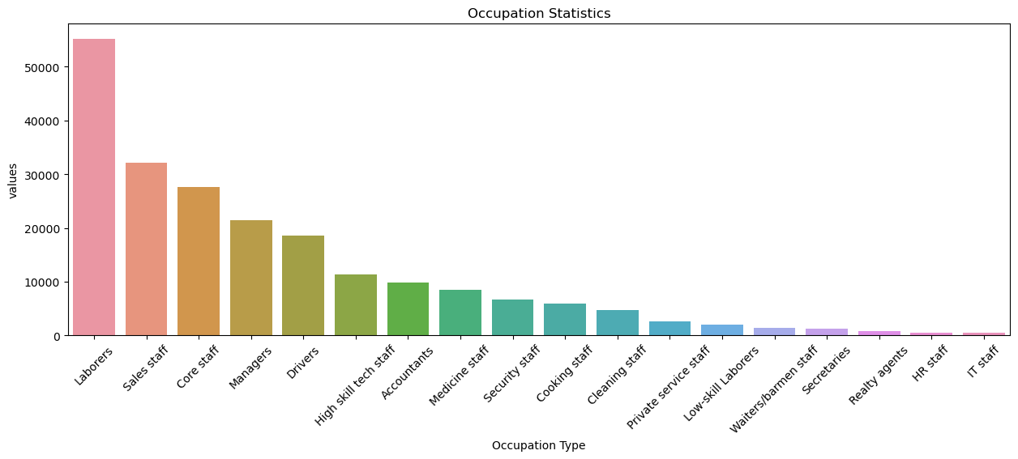
Add a Slide Title - 1
Some Interesting iteration of the Categorical Features into their various levels

Slide 14
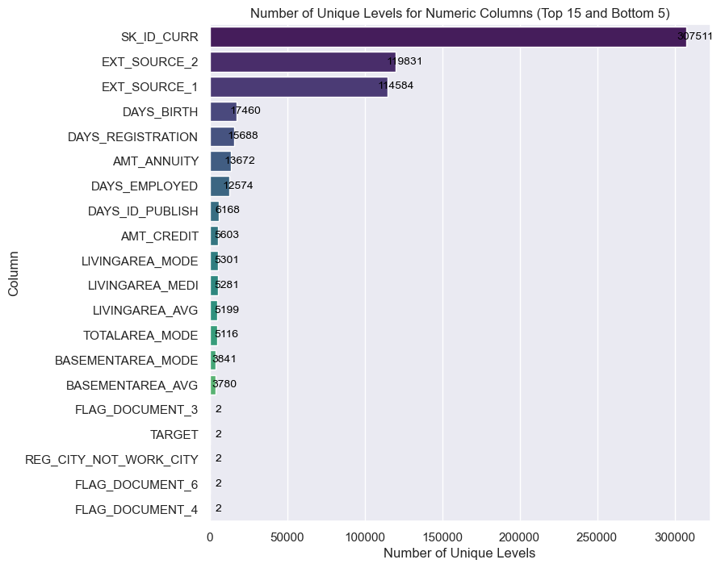
Understanding the Data
The Numerical Features was analyzed as well. The image on the right hand shows the top 15 and the bottom 5 in the numeric features as well as the unique level number.
There were 307511 unique Ids.
17460 unique birthdays.

Slide 15
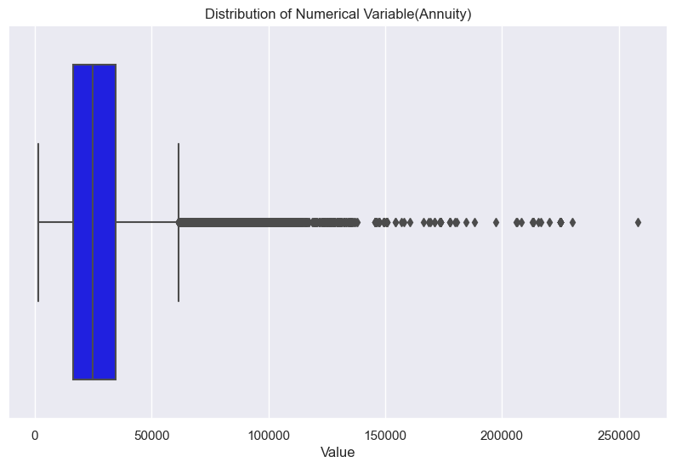
Insight into some selected Numerical Features

Slide 16
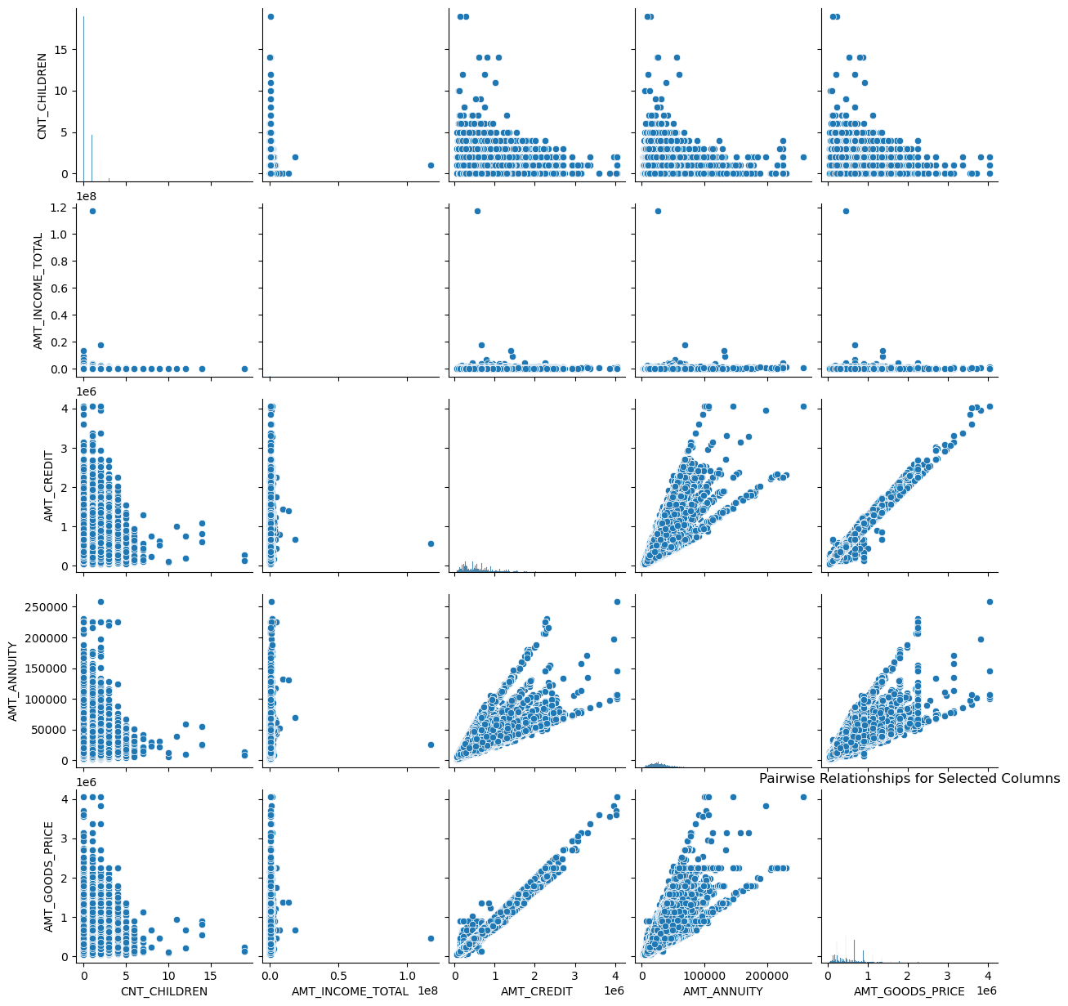
Correlation amongst some randomly selected features

Slide 17

Machine Learning and Model Integration

Slide 18
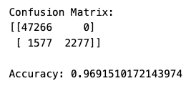
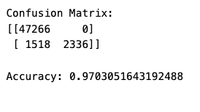
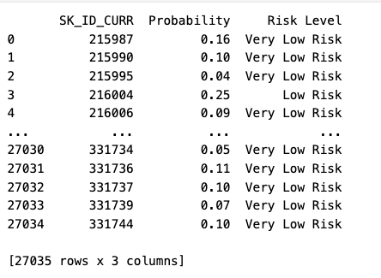
Machine Learning
Probability Prediction
Model : Random Forest Classifier
Performance metrics: Accuracy score and confusion matrix.
Selecting the top 15 important features and re-run the model. Performance metrics check.
Assign probability and risk levels.
The first performance metrics:
After Hyperparameter tuning and Choosing top contributing features in model :

Slide 19
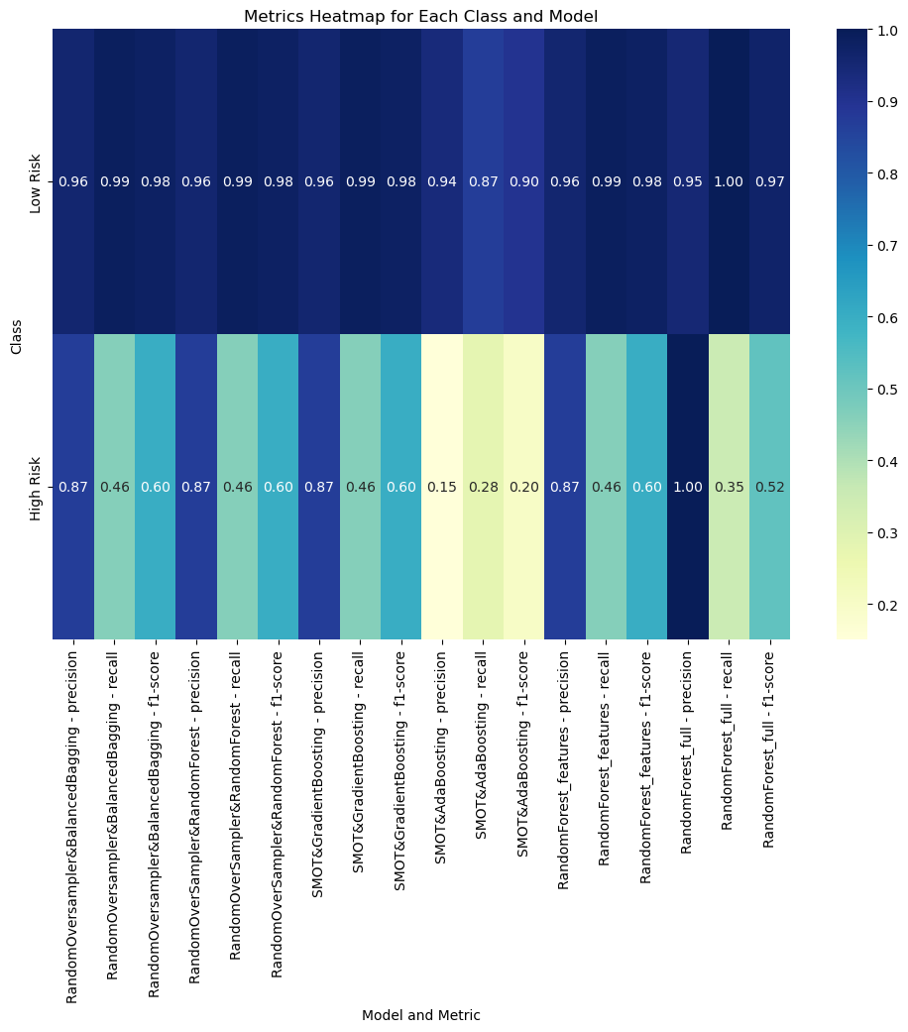
Models and Integration with Front End
Model Selection
Our data has a high level of skewness.
While trying to choose a reasonable model, resampling and ensembling methods used:
Random Over Sampler(ROS)- Random forest Classifier
ROS- Balanced Bagging Classifier
Synthetic Minority over-sampling Technique (SMOTE) - Gradient Boosting
SMOTE - AdaBoosting
Models' predictions were made, and imbalanced classification reports were gathered.
Based on the classification reports a concise heatmap is generated as below:

Slide 20
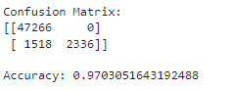
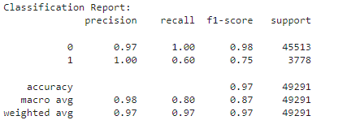
Final Model
Here's the breakdown of the confusion matrix:
True Positives (TP): 2,336
True Negatives (TN): 47,266
False Positives (FP): 1,518
False Negatives (FN): 0
Accuracy: Accuracy is the proportion of correctly classified instances out of the total number of instances. It is calculated as (TP + TN) / (TP + TN + FP + FN). In this case, the accuracy is 0.9703, or 97.03%, indicating that the model correctly classified 97.03% of the instances.
Class 0 (the negative class) has high precision, recall, and F1-score, indicating that the model performs well in identifying negative cases.
Class 1 (the positive class) has perfect precision but lower recall, resulting in a lower F1-score. This suggests that while the model identifies positive cases with high precision, it misses some positive cases.
The weighted average F1-score is 0.97, indicating strong overall performance across both classes.
The macro average F1-score is 0.87, indicating a slightly lower performance when considering class imbalance.

Slide 21
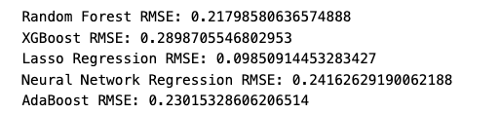
Machine Learning:
Amount Prediction
The insight into the data shows some imbalances therefore the model selected for prediction should be able to improve model performance, handle imbalanced datasets, and reduce overfitting.
Upon further research, we found out that resampling and ensembling are two powerful techniques commonly used in machine learning to improve model performance, handle imbalanced datasets, and reduce overfitting.
Machine learning algorithms used:
- Random Forest
- XG Boost
- Lasso Regression and
- Neural Network Regression
- AdaBoost
Model training and evaluation.
Performance metrics (accuracy, precision, recall, F1-score, etc.).

Slide 22

Front End

Slide 23
Front End
Create Endpoints for Model Prediction:
Defined endpoints or routes in our web application that corresponds to the functionalities of our machine learning model, that created a route to accept input data, preprocess it, and pass it to your model for prediction.
When the model predicts the outcome, return the result as an HTTP response to the client.
Handle Model Integration:
Loaded the serialized model into memory when the web server starts up. This ensures that the model is readily available for prediction.
Integrate the loaded model with the appropriate endpoint handler in your web application.
When a request is received at the prediction endpoint, preprocess the input data as necessary and pass it to the model for prediction.
Return the prediction result to the client, either as JSON data or through a web page rendered with the result.
Deployment:
Deployed our web application to a web server or cloud platform to make it accessible over the internet.
Ensured that the server environment has the necessary dependencies installed, including the machine learning libraries required to load and use the model.
Testing and Monitoring:
Tested the integration thoroughly to ensure that the model behaves as expected in a web environment.
Monitored the performance of our web application and model in production to identify and address any issues that arise.

Slide 24
Limitations and suggestions
Limitations
-Extremely large dataset: Top 99,999 entries are selected to run the model with available resources.
-Imbalanced Classes: Imbalance in the distribution of classes can skew model performance and affect the accuracy of predictions, especially in classification tasks.
- Missing Values: Presence of missing data points can introduce bias and reduce the reliability of statistical analyses and predictive models if not handled properly.
- Limited Feature Representation: The dataset may lack certain important features or variables that could provide deeper insights into the phenomenon under study, limiting the scope of analysis and interpretation.
Live Demo

Slide 25
Final Output
The outcome of this project is summarized in the link below
https://github.com/callmidrey/Project-4--Group-3/blob/main/templates/pre_evaluation.html
Live Demo

